Slide 1
JavaScript
Conditional Statements
PHP web development 2020/2021
Milena Tomova
Vratsa Software
https://vratsasoftware.com/

Slide 2
Table of Contents
truthy and falsy
comparison and logical operators
if/else
switch
functions for string manipulation

Slide 3
truthy & falsy

Slide 4
truthy
truthy /expressions that evaluate to true/
if (true)
if ({})
if ([])
if (42)
if ("0")
if ("false")
if (new Date())
if (-42)
if (12n)
if (3.14)
if (-3.14)
if (Infinity)
if (-Infinity)
resource

Slide 5
falsy
falsy /expressions that evaluate to false/
false /The keyword false/
0 /The number zero/
-0 /The number negative zero/
0n /BigInt, when used as a boolean, follows the same rule as a Number. 0n is falsy./
"" /Empty string value/
null /the absence of any value/
undefined /the primitive value/
NaN /not a number/
resource

Slide 6
comparison and logical operators

Slide 7
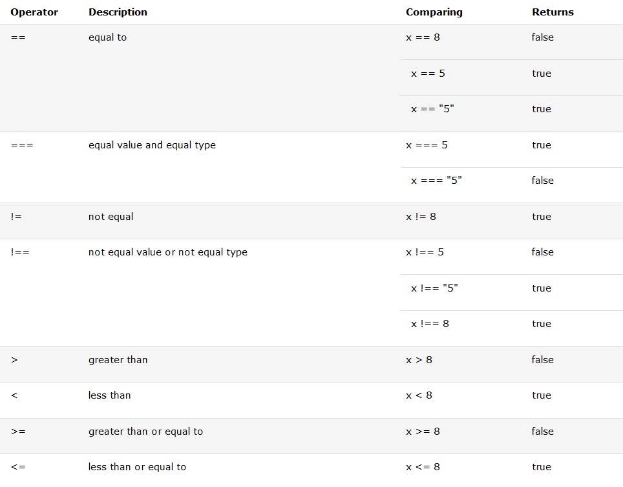
Comparison operators

Slide 8
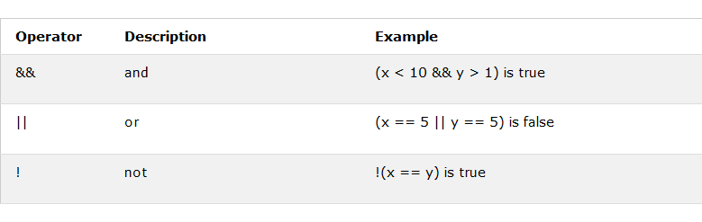
Logical operators

Slide 9
Ternary operator
Syntax
variablename = (condition) ? value1:value2
Example
var voteable = (age < 18) ? "Too young":"Old enough";
Result
17// Too young
25// Old enough

Slide 10
Comparing different types
2 < 12 //true
2 < "12" //true
2 < "John" //false
2 > "John" //false
2 == "John" //false
"2" < "12" //false
"2" > "12" //true
"2" == "12"//false

Slide 11
if/else if/else

Slide 12
if/else if/else
Syntax
if (condition1) {
//
} else if (condition2) {
//
} else {
//
}

Slide 13
if/else if/else
Example
var greeting;
if (time < 10) {
greeting = "Good morning";
} else if (time < 20) {
greeting = "Good day";
} else {
greeting = "Good evening";
}
alert( greeting );

Slide 14
switch

Slide 15
switch
Syntax
switch(expression) {
case x:
// code block
break;
case y:
// code block
break;
default:
// code block
}

Slide 16
switch
Example
The getDay() method returns the weekday as a number between 0 and 6.
(Sunday=0, Monday=1, Tuesday=2 ..)
switch (new Date().getDay()) {
case 0:
day = "Sunday";
break;
case 1:
day = "Monday";
break;
case 2:
day = "Tuesday";
break;
case 3:
day = "Wednesday";
break;
case 4:
day = "Thursday";
break;
case 5:
day = "Friday";
break;
case 6:
day = "Saturday";
}

Slide 17
switch
Example 2
Switching Details
If multiple cases matches a case value, the first case is selected.
If no matching cases are found, the program continues to the default label.
If no default label is found, the program continues to the statement(s) after the switch.
switch (new Date().getDay()) {
case 6:
text = "Today is Saturday";
break;
case 0:
text = "Today is Sunday";
break;
default:
text = "Looking forward to the Weekend";
}

Slide 18
switch
Example 3
Strict Comparison
Switch cases use strict comparison (===).
The values must be of the same type to match.
A strict comparison can only be true if the operands are of the same type.
In this example there will be no match for x:
more info
var x = "0";
switch (x) {
case 0:
text = "Off";
break;
case 1:
text = "On";
break;
default:
text = "No value found";
}

Slide 19
string properties and methods

Slide 20
String properties and methods
Properties
length returns the number of characters in a string
some JS String Methods
indexOf() method returns the position of the first occurrence of a specified value in a string. Returns -1 if the value to search for never occurs.
replace() method searches a string for a specified value, or a regular expression, and returns a new string where the specified values are replaced
slice() Extracts a part of a string and returns a new string
split() Splits a string into an array of substrings
more info
some JS String Methods
substr() Extracts the characters from a string, beginning at a specified start position, and through the specified number of character
trim() Removes whitespace from both ends of a string
toLowerCase() Converts a string to lowercase letters
toUpperCase() Converts a string to uppercase letters

Slide 23



Trainings @ Vratsa Software
Vratsa Software – High-Quality Education, Profession and Jobs
www.vratsasoftware.com
The Nest Coworking
www.nest.bg
Vratsa Software @ Facebook
www.fb.com/VratsaSoftware
Slack Channel
www.vso.slack.com

